Slide 1

Introduction

Slide 2

Contents of introduction

Slide 3
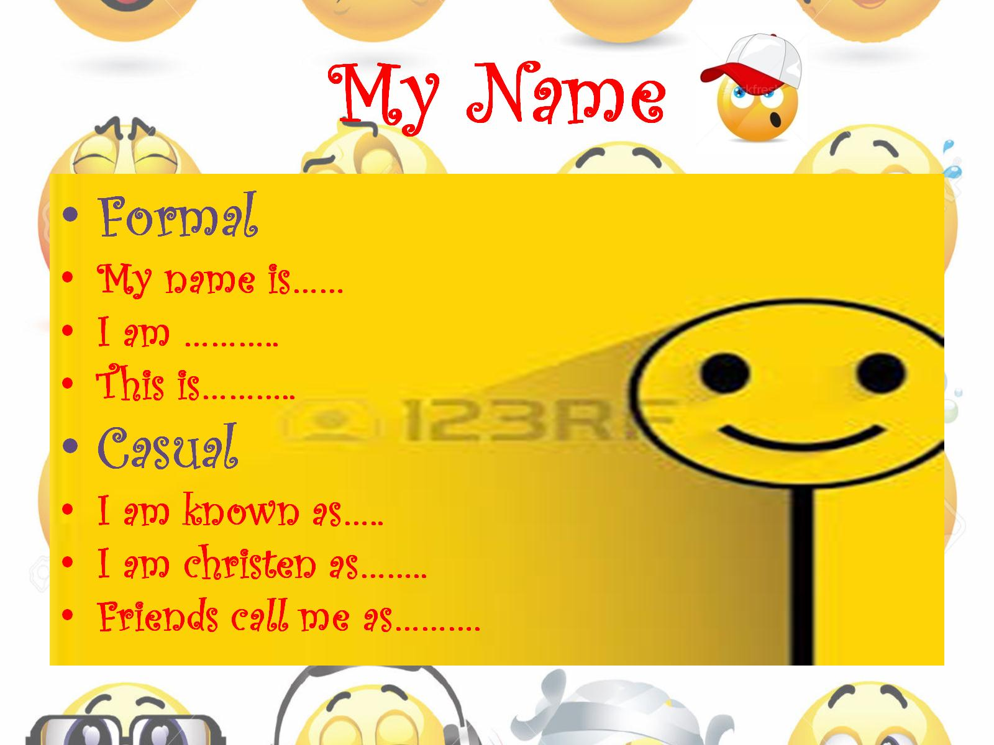
My Name

Slide 4

I live

Slide 5

My Qualifications

Slide 6

My Experience

Slide 7

My Family

Slide 8

My Family

Slide 9

Area of Interest…

Slide 10


Slide 11


